Slide 1
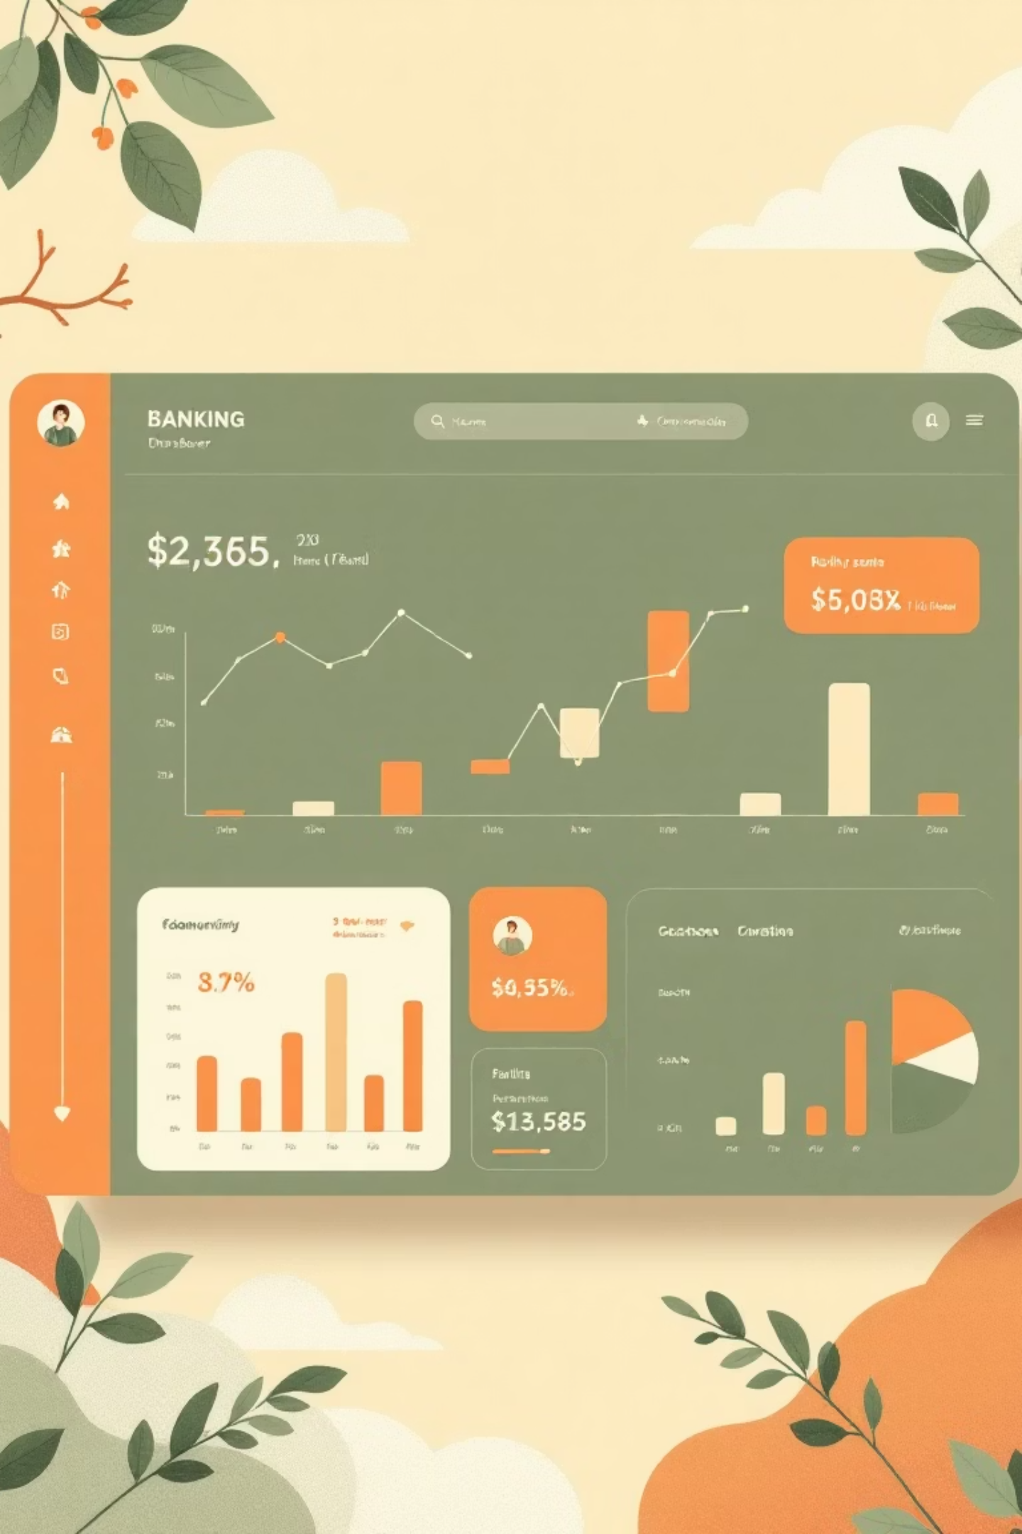
Banking Risk Analytics in Financial Services
Understanding how data minimizes lending risk while maximizing customer value through comprehensive banking analytics.
Made by - Bhawna Kumari

Slide 2

Project Overview
Dataset Structure
Technology Stack
Multi-table banking database with 3,000 rows and 25 columns, containing client details, banking relationships, and investment data linked through primary and foreign keys.
MySQL for database management
Python with Pandas for analysis
Power BI with DAX for visualization
Matplotlib & Seaborn for EDA

Slide 3




Workflow Architecture
Database Setup
Python Integration
Created MySQL banking database and imported 3,000-row dataset
Connected MySQL with Python using pymysql library
EDA Process
Dashboard Build
Cleaned, transformed, and visualized data in Google Colab
Imported processed data into Power BI for business insights

Slide 4




Exploratory Data Analysis
Descriptive Statistics
Income Segmentation
Income and loan distributions showed right-skewed patterns, indicating a small subset of high-value clients driving portfolio value.
Categorized income into Low, Medium, and High tiers. High-income customers dominate, reinforcing Private Banking concentration.
Categorical Analysis
Assessed demographic distribution, customer segmentation, and loyalty tiers to detect lending or deposit patterns.

Slide 5

Correlation Insights
Key Findings
Most clients are professionals in technical or structural roles, consistent with high-income segmentation patterns observed throughout the analysis.
Strong positive correlation between Bank Deposits, Checking Accounts, and Saving Accounts
Moderate correlation between Business Lending and Bank Loans indicates potential overlap in loan exposure
Weak correlation between Credit Card Balance and total lending suggests separate risk profile

Slide 6

Power BI Data Preparation
01
02
03
Engagement Days Column
Processing Fees Logic
Income Band Bins
Calculated client tenure from joining date to measure relationship longevity
Applied conditional formatting: high fee structure = 0.05 processing fee
Created bins: <$100K as Low, <$300K as Mid, remainder as High income
DAX Formulas Created: Total Deposit (sum of all deposit accounts), Total Loan (sum of all lending products), Total Fees (loan amount × processing fees)

Slide 7

Loan Portfolio Analysis
$4.4B
59%
53%
Total Loans
Business Lending
High-Income Share
$1.8B bank loans, $2.6B business lending, $9.5M credit cards
Dominates loan book, indicating corporate client focus
$942.49M held by high-income clients
Private Banks lead significantly in loan issuance. European clients dominate the portfolio, with top borrowing occupations including Account Coordinators, Database Professionals, and Office Assistants.

Slide 8
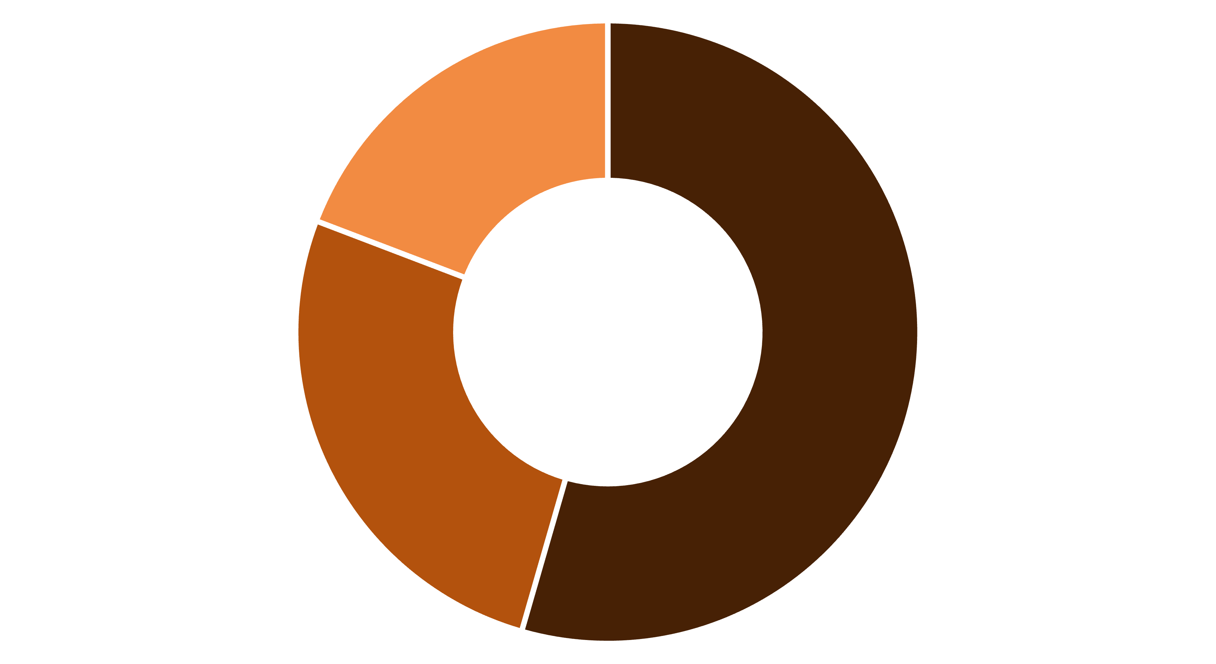
Deposit Distribution
Bank Deposits
Checking Accounts
Savings Accounts
Total deposits: $3.8 billion. Private Banks dominate deposit volume, indicating high-value, low-volume client structure. High-income clients contribute 54% ($2.03B) of total deposits.
European clients hold the largest share, followed by Asian and American customers. Geographic diversification is limited with strong Euro-centric concentration.

Slide 9

Strategic Insights
Concentration Risk
Growth Opportunities
Loan and deposit exposure concentrated in Private Banking and high-income clients. Geographic risk centered on European markets requires diversification.
Consumer credit underrepresented with minimal credit card penetration. Expansion potential in mass retail products and diversified income tiers.
Portfolio Stability
Current distribution ensures stability via high-creditworthiness clients but limits scalability. Balance needed between risk-return and sustained growth.

Slide 10

Conclusion & Future Work
Key Achievements
Future Opportunities
Power BI dashboards provide effective visualization of banking operations, enabling banks to track loan amounts, client distribution, and account metrics by investor type.
Track individual investor portfolios in real-time
Analyze nationality-based lending patterns
Develop strategies to increase client acquisition
Private banks show highest client concentration, offering strategic insights for competitive positioning.
Monitor account type performance metrics

Slide 11





Further Exploration & Connect
Dive deeper into the data analysis and code on the Google Colab platform:
Access Google Colab Notebook
Connect with the Author
Bhawna Kumari
Email
Data Analyst | SQL, Python, Power BI, Excel, Tableau
b
LinkedIn
Github
/https://www.linkedin.com/in/bhawna-kumari-data-analyst/
Bhawna013 - Overview

